Slide 1
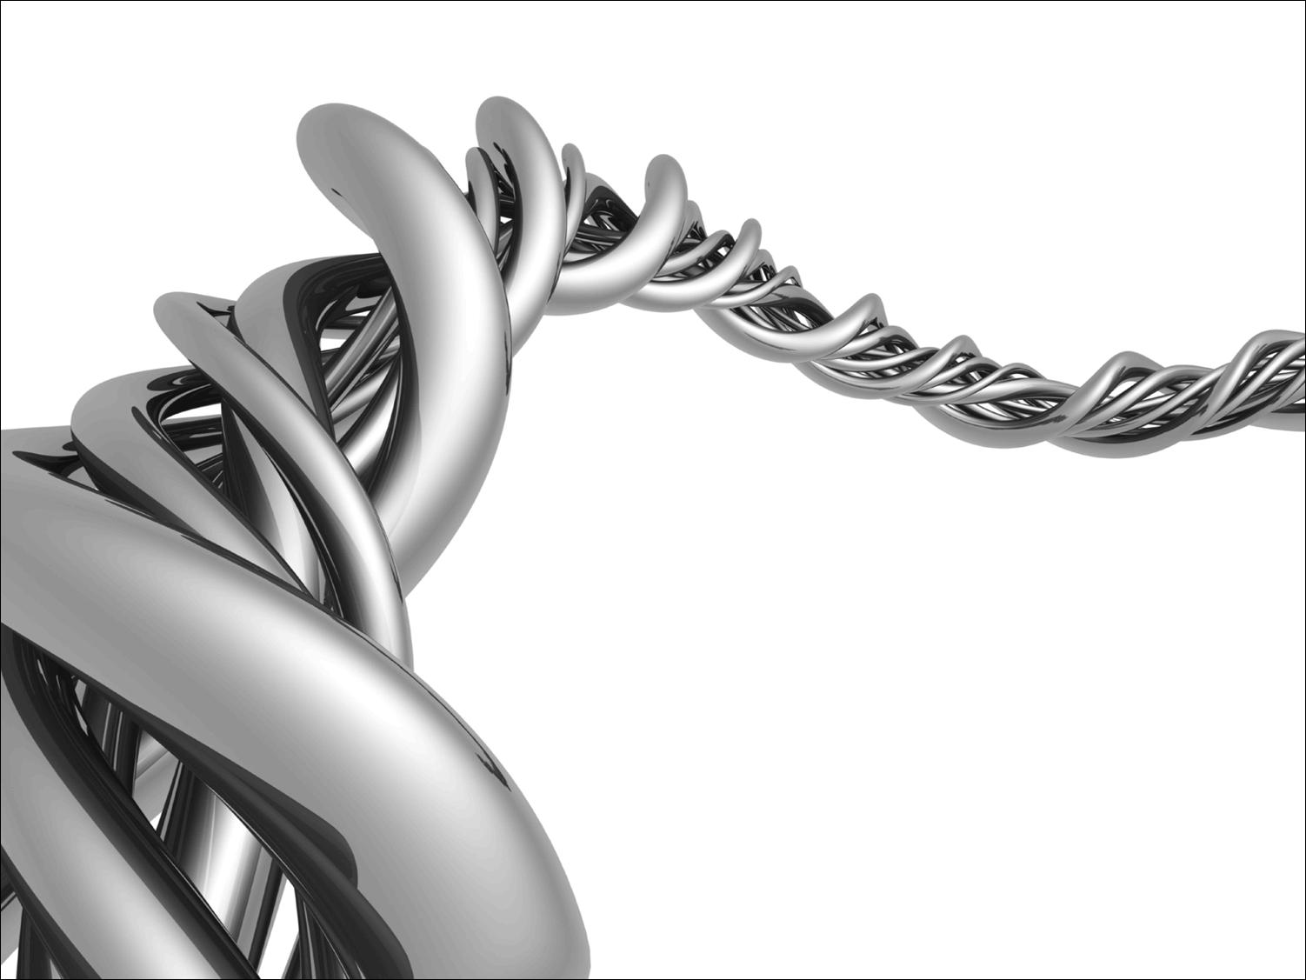
Fundamentals of Python:
First Programs
Chapter 7: Simple Graphics
and Image Processing

Slide 2

Objectives
After completing this chapter, you will be able to:
Use the concepts of object-based programming—classes, objects, and methods—to solve a problem
Develop algorithms that use simple graphics operations to draw two-dimensional shapes
Use the RGB system to create colors in graphics applications and modify pixels in images
Fundamentals of Python: First Programs

Slide 3
Objectives (continued)
Develop recursive algorithms to draw recursive shapes
Write a nested loop to process a two-dimensional grid
Develop algorithms to perform simple transformations of images, such as conversion of color to grayscale
Fundamentals of Python: First Programs

Slide 4
Simple Graphics
Graphics: Discipline that underlies the representation and display of geometric shapes in two- and three-dimensional space
A Turtle graphics toolkit provides a simple and enjoyable way to draw pictures in a window
  turtle is a non-standard, open-source Python module
Fundamentals of Python: First Programs

Slide 5
Overview of Turtle Graphics
Turtle graphics originally developed as part of the children’s programming language Logo
  Created by Seymour Papert and his colleagues at MIT in the late 1960s
Analogy: Turtle crawling on a piece of paper, with a pen tied to its tail
  Sheet of paper is a window on a display screen
  Position specified with (x, y) coordinates
    Cartesian coordinate system, with origin (0, 0) at the center of a window
Fundamentals of Python: First Programs

Slide 6
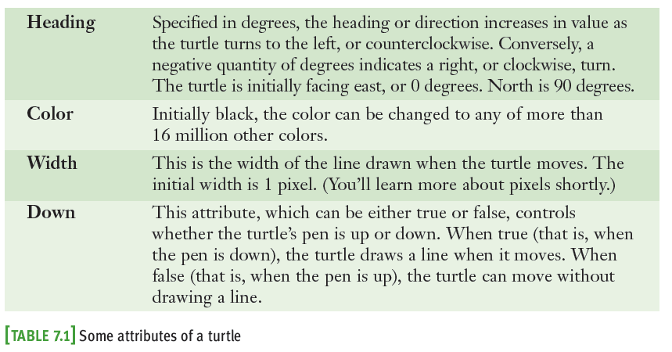
Overview of Turtle Graphics (continued)
Together, these attributes make up a turtle’s state
Fundamentals of Python: First Programs

Slide 7
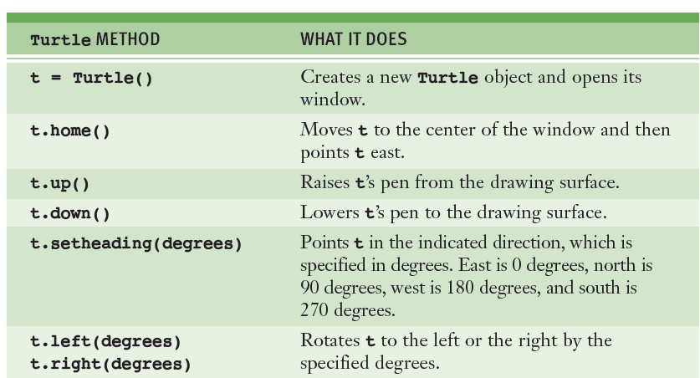

Turtle Operations
Fundamentals of Python: First Programs

Slide 8
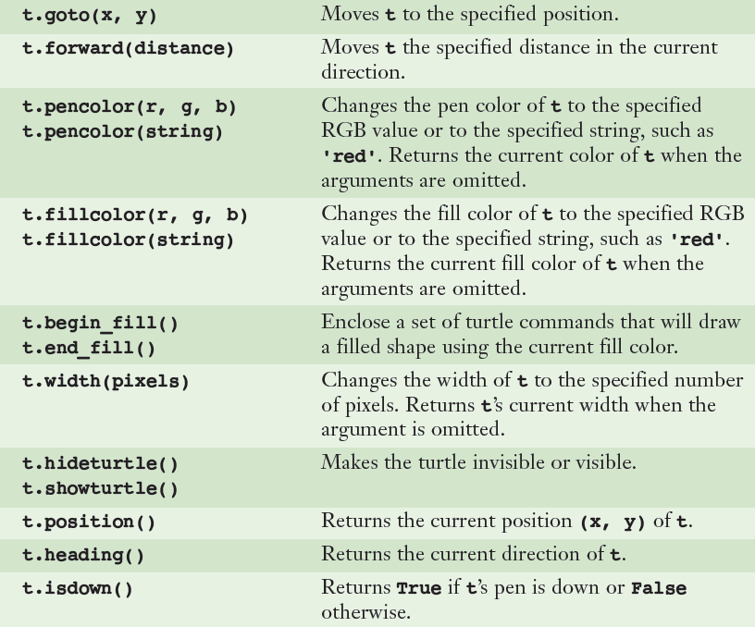
Turtle Operations (continued)
Fundamentals of Python: First Programs

Slide 9
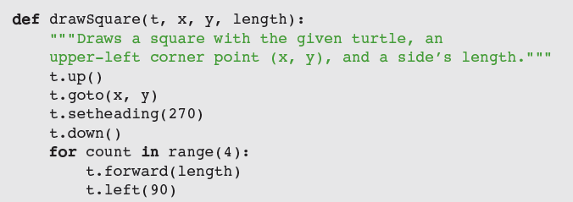
Turtle Operations (continued)
Interface: set of methods of a given class
  Used to interact with an object
  Use docstring mechanism to view an interface
    help(<class name>)
    help(<class name>.<method name>)
Fundamentals of Python: First Programs

Slide 10


Object Instantiation and the turtle Module
Before you apply any methods to an object, you must create the object (i.e., an instance of)
Instantiation: Process of creating an object
Use a constructor to instantiate an object:
To instantiate the Turtle class:
Fundamentals of Python: First Programs

Slide 11
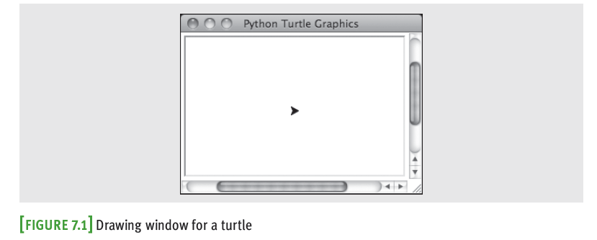
Object Instantiation and the turtle Module (continued)
To close a turtle’s window, click its close box
Attempting to manipulate a turtle whose window has been closed raises an error
Fundamentals of Python: First Programs

Slide 12
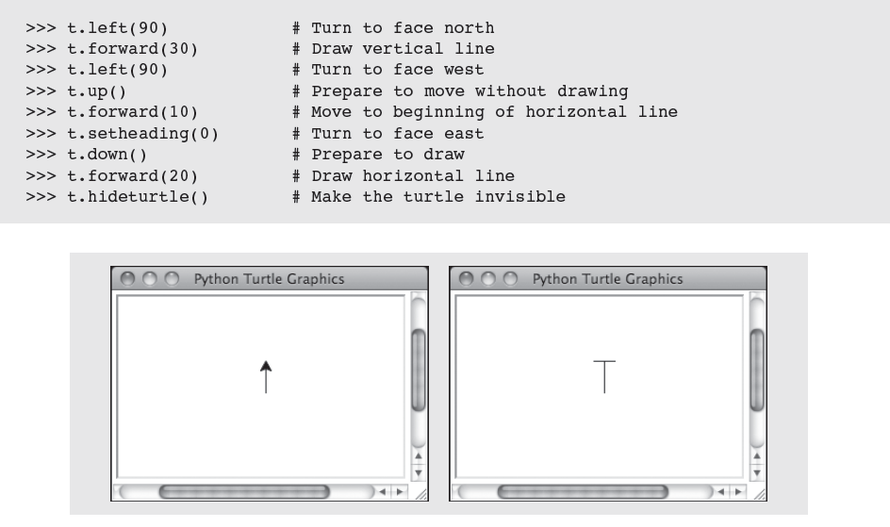
Object Instantiation and the
turtle Module (continued)
Fundamentals of Python: First Programs

Slide 13
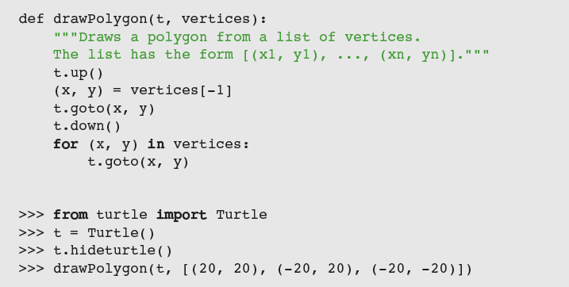
Drawing Two-Dimensional Shapes
Many graphics applications use vector graphics, or the drawing of simple two-dimensional shapes, such as rectangles, triangles, and circles
Fundamentals of Python: First Programs

Slide 14
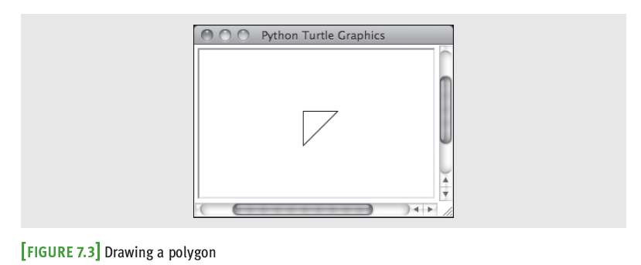
Drawing Two-Dimensional Shapes (continued)
Fundamentals of Python: First Programs

Slide 15
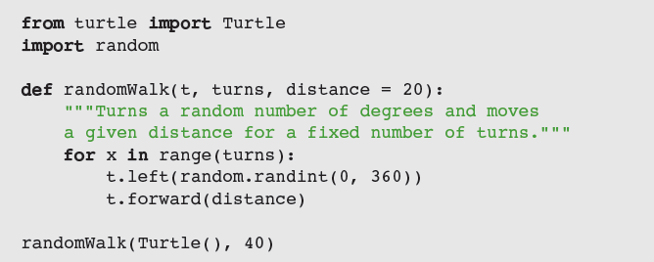
Taking a Random Walk
Like any animal, a turtle can wander around randomly:
Fundamentals of Python: First Programs

Slide 16
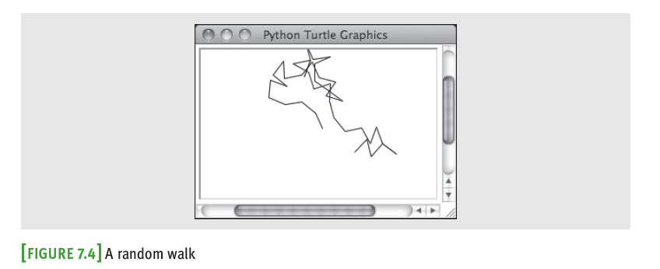
Taking a Random Walk (continued)
Fundamentals of Python: First Programs

Slide 17
Colors and the RGB System
Display area on a computer screen is made up of colored dots called picture elements or pixels
Each pixel represents a color – the default is black
RGB is a common system for representing colors
  RGB stands for red, green, and blue
  Each color component can range from 0 – 255
    255 → maximum saturation of a color component
    0 → total absence of that color component
  A true color system
Fundamentals of Python: First Programs

Slide 18
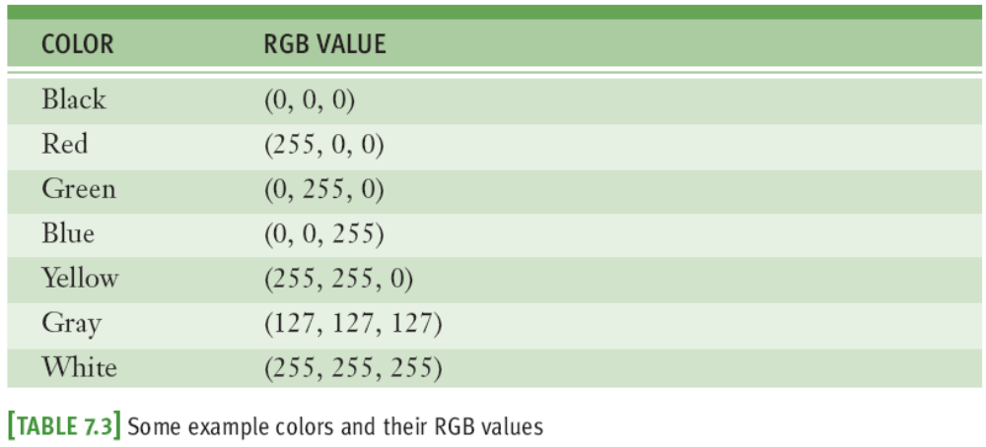
Colors and the RGB System (cont’d)
Each color component requires 8 bits; total number of bits needed to represent a color value is 24
  Total number of RGB colors is 2²⁴ (16,777,216)
Fundamentals of Python: First Programs

Slide 19
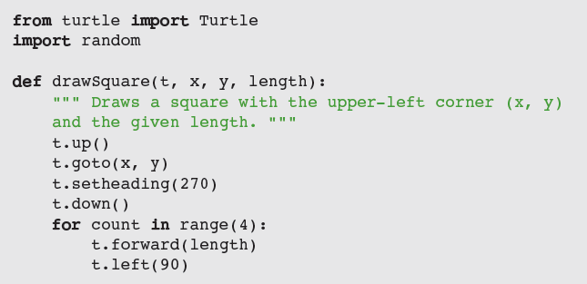
Example: Drawing with Random Colors
The Turtle class includes a pencolor method for changing the turtle’s drawing color
  Expects integers for the three RGB components
Fundamentals of Python: First Programs

Slide 20
Examining an Object's Attributes
Mutator methods change the internal state of a Turtle method
  Example: pencolor method
Accessor methods return the values of a Turtle object’s attributes without altering its state
  Example: position method
Fundamentals of Python: First Programs

Slide 21

Manipulating a Turtle’s Screen
The Screen object’s attributes include its width and height in pixels and its background color
Use t.screen to access a turtle’s Screen object, then call a Screen method on this object
Fundamentals of Python: From First Programs Through Data Structures

Slide 22
Case Study: Recursive Patterns in Fractals
Fractals are highly repetitive or recursive patterns
A fractal object appears geometric, yet it cannot be described with ordinary Euclidean geometry
Strangely, a fractal curve is not one-dimensional, and a fractal surface is not two-dimensional
  Every fractal shape has its own fractal dimension
One example of a fractal curve is the c-curve
Fundamentals of Python: First Programs

Slide 23
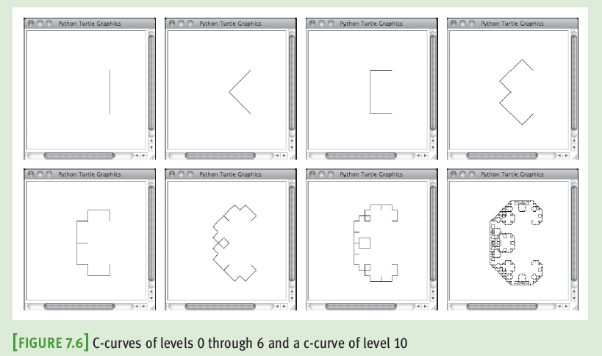
Case Study: Recursive Patterns in Fractals (continued)
Fundamentals of Python: First Programs

Slide 24
Case Study: Recursive Patterns in Fractals (continued)
Request:
  Write a program that allows the user to draw a particular c-curve in varying degrees
Analysis:
  Program should prompt the user for the level of the c-curve
  Next, program should display a Turtle graphics window in which it draws the c-curve
Fundamentals of Python: First Programs

Slide 25
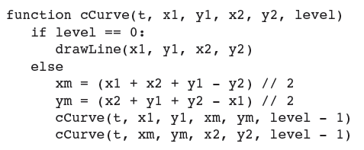
Case Study: Recursive Patterns in Fractals (continued)
Design:
Fundamentals of Python: First Programs

Slide 26
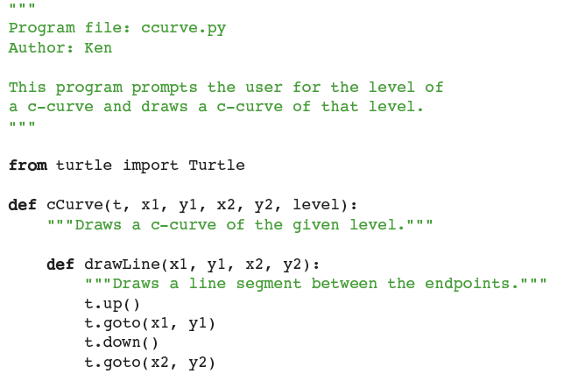
Case Study (continued)
Implementation:
Fundamentals of Python: First Programs

Slide 27
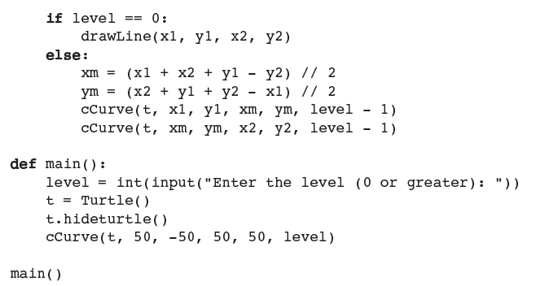
Case Study (continued)
Implementation (continued):
Fundamentals of Python: First Programs

Slide 28
Image Processing
Digital image processing includes the principles and techniques for the following:
  The capture of images with devices such as flatbed scanners and digital cameras
  The representation and storage of images in efficient file formats
  Constructing the algorithms in image-manipulation programs such as Adobe Photoshop
Fundamentals of Python: First Programs

Slide 29
Analog and Digital Information
Computers must use digital information which consists of discrete values
  Example: Individual integers, characters of text, or bits
The information contained in images, sound, and much of the rest of the physical world is analog
  Analog information contains a continuous range of values
Ticks representing seconds on an analog clock’s face represent an attempt to sample moments of time as discrete values (time itself is analog)
Fundamentals of Python: First Programs

Slide 30
Sampling and Digitizing Images
A visual scene projects an infinite set of color and intensity values onto a two-dimensional sensing medium
  If you sample enough of these values, digital information can represent an image more or less indistinguishable (to human eye) from original scene
Sampling devices measure discrete color values at distinct points on a two-dimensional grid
  These values are pixels
  As more pixels are sampled, the more realistic the resulting image will appear
Fundamentals of Python: First Programs

Slide 31
Image File Formats
Once an image has been sampled, it can be stored in one of many file formats
A raw image file saves all of the sampled information
Data can be compressed to minimize its file size
  JPEG (Joint Photographic Experts Group)
    Uses lossless compression and a lossy scheme
  GIF (Graphic Interchange Format)
    Uses a lossy compression and a color palette of up to 256 of the most prevalent colors in the image
Fundamentals of Python: First Programs

Slide 32
Image-Manipulation Operations
Image-manipulation programs either transform the information in the pixels or alter the arrangement of the pixels in the image
Examples:
  Rotate an image
  Convert an image from color to grayscale
  Blur all or part of an image
  Sharpen all or part of an image
  Control the brightness of an image
  Perform edge detection on an image
  Enlarge or reduce an image’s size
Fundamentals of Python: First Programs

Slide 33
The Properties of Images
The coordinates of pixels in the two-dimensional grid of an image range from (0, 0) at the upper-left corner to (width-1, height-1) at lower-right corner
  width/height are the image’s dimensions in pixels
  Thus, the screen coordinate system for the display of an image is different from the standard Cartesian coordinate system that we used with Turtle graphics
The RGB color system is a common way of representing the colors in images
Fundamentals of Python: First Programs

Slide 34
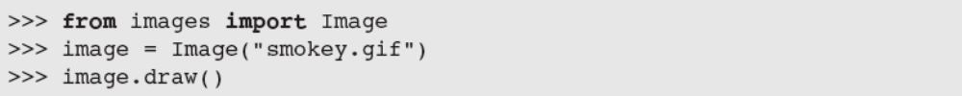
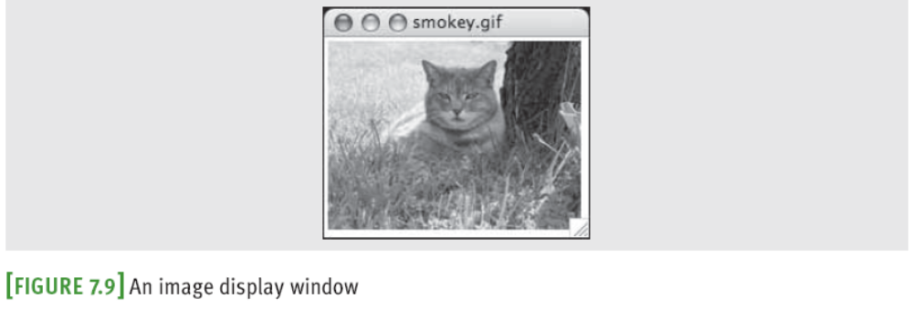
The images Module
Non-standard, open-source Python tool
  Image class represents an image as a two-dimensional grid of RGB values
Fundamentals of Python: First Programs

Slide 35
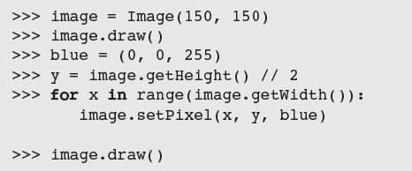
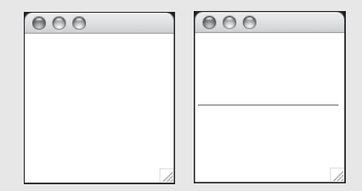

The images Module (continued)
Fundamentals of Python: First Programs

Slide 36
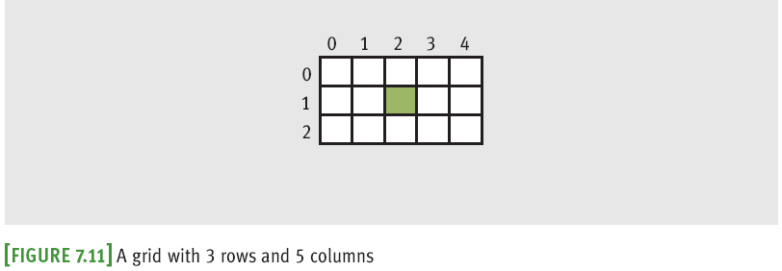
A Loop Pattern for Traversing a Grid
Most of the loops we have used in this book have had a linear loop structure
Many image-processing algorithms use a nested loop structure to traverse a two-dimensional grid of pixels
Fundamentals of Python: First Programs

Slide 37
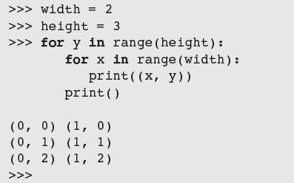

A Loop Pattern for Traversing a Grid (continued)
Previous loop uses a row-major traversal
  We use this template to develop many of the algorithms that follow:
Fundamentals of Python: First Programs

Slide 38
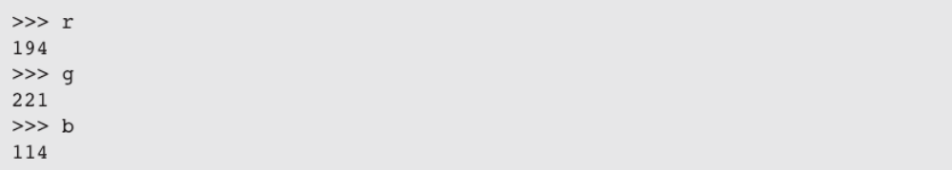
A Word on Tuples
A pixel’s RGB values are stored in a tuple:
Fundamentals of Python: First Programs

Slide 39
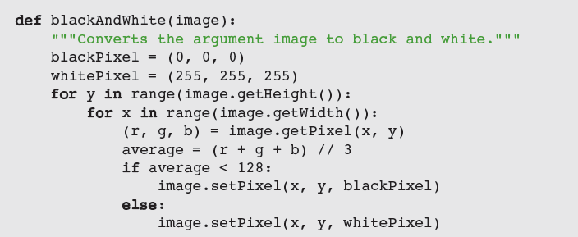
Converting an Image to Black and White
For each pixel, compute average of R/G/B values
Then, reset pixel’s color values to 0 (black) if the average is closer to 0, or to 255 (white) if the average is closer to 255
Fundamentals of Python: First Programs

Slide 40
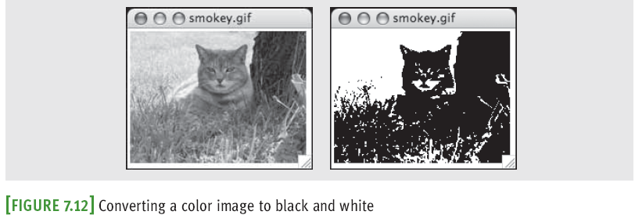
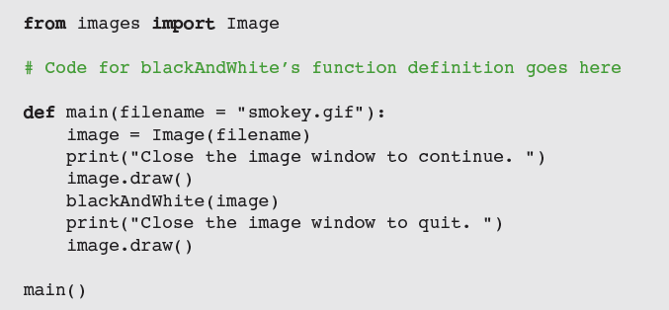
Converting an Image to Black and White (continued)
Fundamentals of Python: First Programs

Slide 41

Converting an Image to Grayscale
Black and white photographs contain various shades of gray known as grayscale
Grayscale can be an economical scheme (the only color values might be 8, 16, or 256 shades of gray)
A simple method:
  Problem: Does not reflect manner in which different color components affect human perception
Scheme needs to take differences in luminance into account
Fundamentals of Python: First Programs

Slide 42
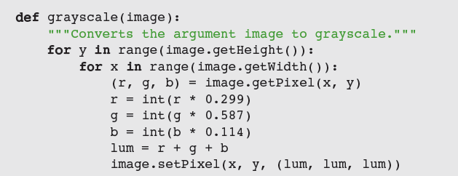
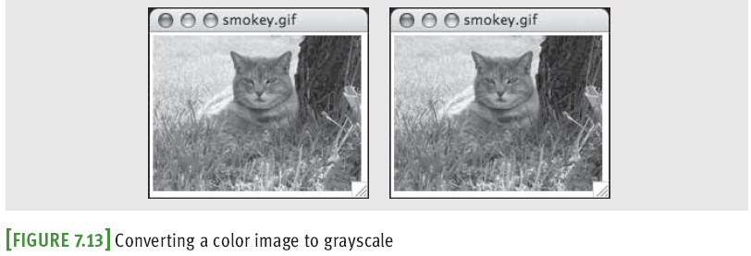
Converting an Image to Grayscale (continued)
Fundamentals of Python: First Programs

Slide 43
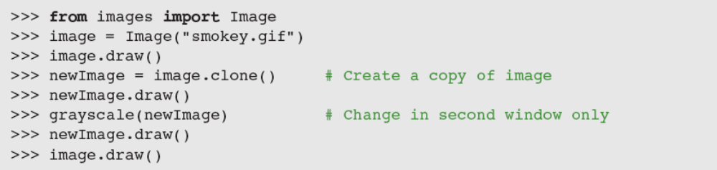
Copying an Image
The method clone builds and returns a new image with the same attributes as the original one, but with an empty string as the filename
Fundamentals of Python: First Programs

Slide 44
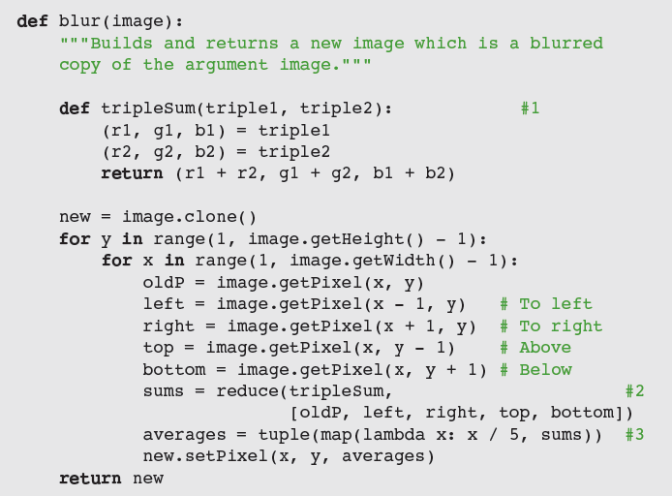
Blurring an Image
Pixilation can be mitigated by blurring
Fundamentals of Python: First Programs

Slide 45
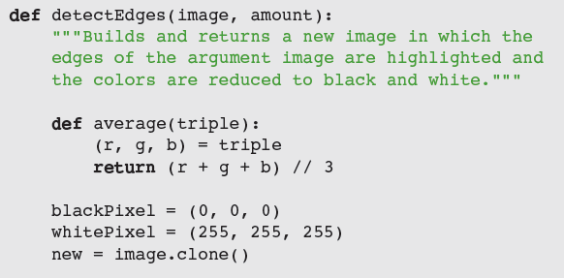

Edge Detection
Edge detection removes the full colors to uncover the outlines of the objects represented in the image
Fundamentals of Python: First Programs

Slide 46
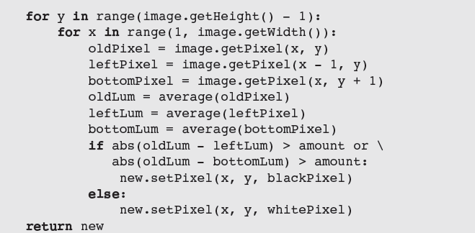
Edge Detection (continued)
Fundamentals of Python: First Programs

Slide 47
Reducing the Image Size
The size and the quality of an image on a display medium depend on two factors:
  Image’s width and height in pixels
  Display medium’s resolution
    Measured in pixels, or dots per inch (DPI)
The resolution of an image can be set before the image is captured
  A higher DPI causes sampling device to take more samples (pixels) through the two-dimensional grid
A size reduction usually preserves an image’s aspect ratio
Fundamentals of Python: First Programs

Slide 48
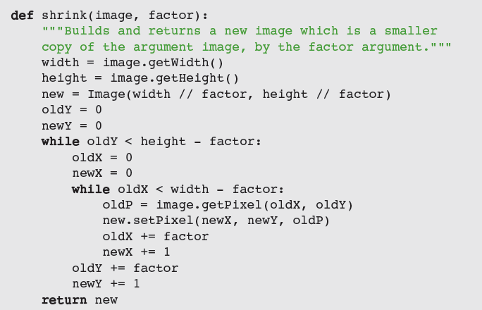
Reducing the Image Size (continued)
Reducing size throws away some pixel information
Fundamentals of Python: First Programs

Slide 49
Summary
Object-based programming uses classes, objects, and methods to solve problems
A class specifies a set of attributes and methods for the objects of that class
The values of the attributes of a given object make up its state
A new object is obtained by instantiating its class
The behavior of an object depends on its current state and on the methods that manipulate this state
The set of a class’s methods is called its interface
Fundamentals of Python: First Programs

Slide 50
Summary (continued)
Turtle graphics is a lightweight toolkit used to draw pictures in a Cartesian coordinate system
RGB system represents a color value by mixing integer components that represent red, green, and blue intensities
A grayscale system uses 8, 16, or 256 distinct shades of gray
Fundamentals of Python: First Programs

Slide 51
Summary (continued)
Digital images are captured by sampling analog information from a light source, using a device such as a digital camera or a flatbed scanner
  Can be stored in several formats, like JPEG and GIF
When displaying an image file, each color value is mapped onto a pixel in a two-dimensional grid
  A nested loop structure is used to visit each position
Image-manipulation algorithms either transform pixels at given positions or create a new image using the pixel information of a source image
Fundamentals of Python: First Programs

